Slide 1
CAR PRICE PREDICTION
MAUL SRI M
DA & DS ONLINE B5
26-02-2025

Slide 2
INTRODUCTION
Analyzing Car Prices and Trends.
Factors Influencing Car Pricing.
Visualization of Price Relationships.
Explore pricing trends interactively.
Dashboard is designed for car buyers, sellers, and dealerships.

Slide 3
DATASET OVERVIEW
Car ID: Unique identifier for each car.
Brand: Car manufacturer (e.g., Toyota, Ford, BMW).
Year: Year the car was manufactured.
Engine Size: The size of the car's engine, which can influence price.
Fuel Type: Type of fuel the car uses (e.g., petrol, diesel, electric, hybrid).
Transmission: Type of transmission (e.g., manual, automatic).
Mileage: The total distance the car has traveled.
Condition: Describes the overall state of the car (e.g., excellent, good, poor).
Price: The price of the ca)r
Model: Specific model of the car.
Custom Date: Additional date data, such as when the car was listed for sale.

Slide 4
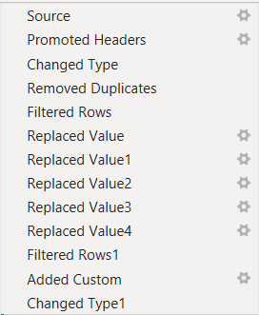
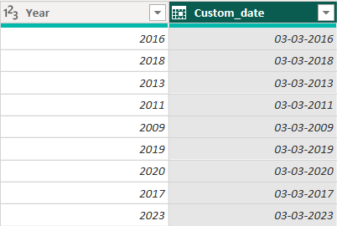
DATA CLEANING
Formatting headers
Ensure data types
No duplicates
No outliers
No blanks

Slide 5
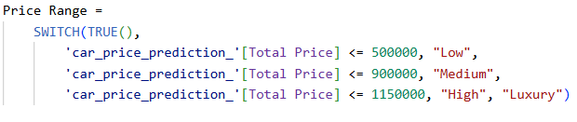
DAX FUNCTION

Slide 6
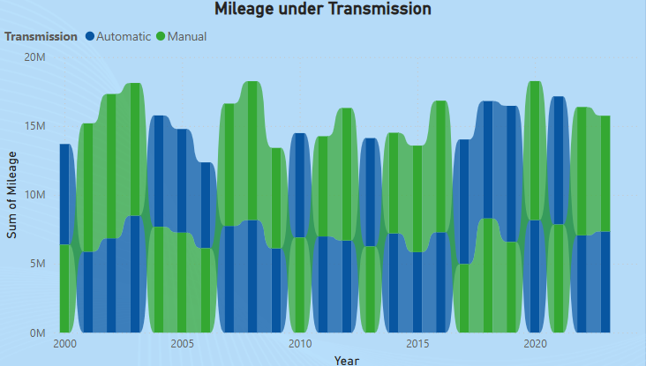
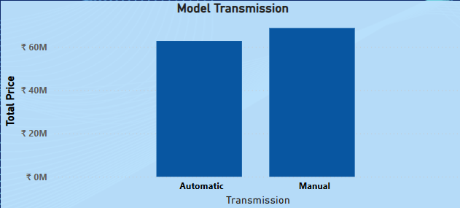
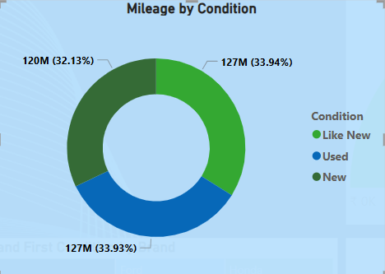
CHARTS

Slide 7
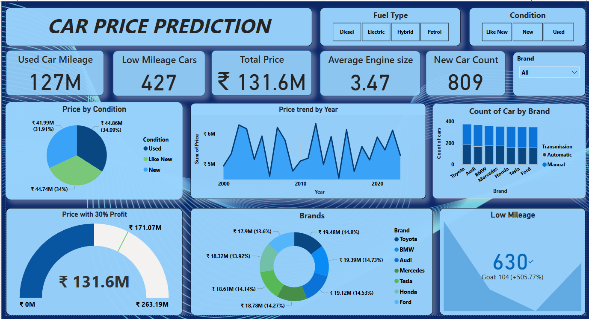
DASHBOARD OVERVIEW

Slide 8
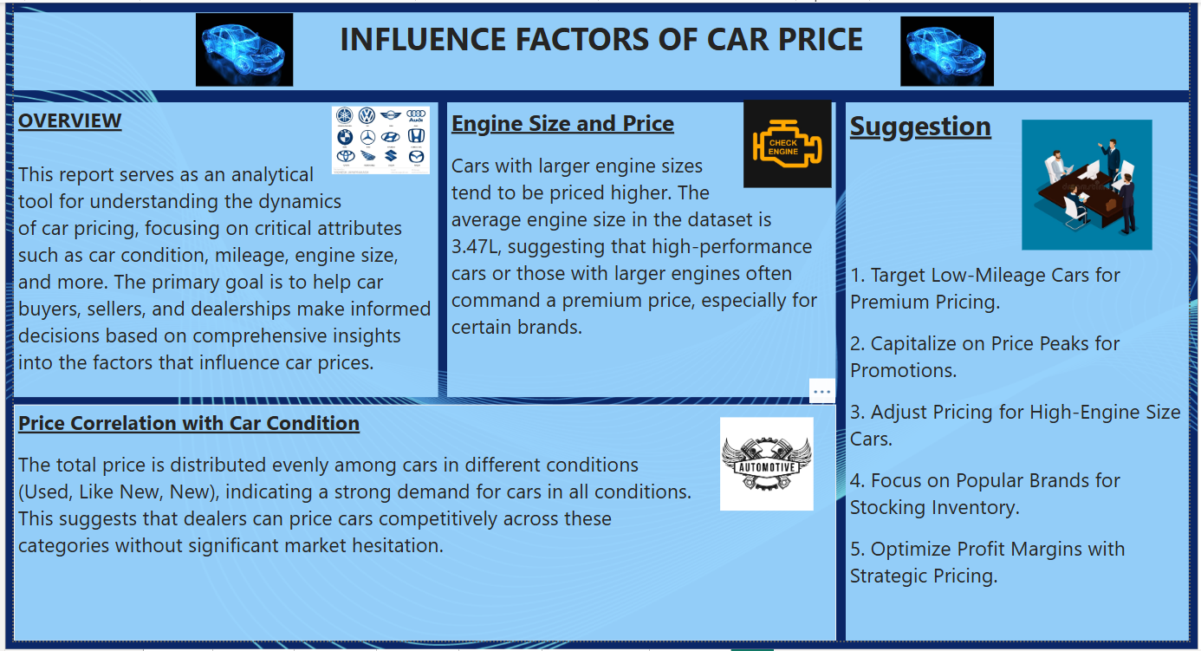
REPORT

Slide 9
KEY INSIGHTS
Popular brands such as Toyota and Audi dominate the market.
Manual transmission car dominate over automatics cars.
Each brand contributing between 13% and 15% to the total price.
Balanced distribution across the car condition.
Price peaks in specific years like 2002, 2012, and 2022 based on demands.

Slide 10
RECOMMENDATION
High count of low-mileage cars to target premium buyers
Focusing on years with high demand.
Capitalize on price through promotion.
Suggesting stable demand for all brands in the market.

Slide 11
CONCLUSION
Effective Use of Data.
Targeting High-Value Segments.
Future Opportunities for Optimization.
Offer a strong understanding of the car market's behavior and pricing fluctuations.

